Slide 1

Predicting Charity Fundraising
Abhijith Tammanagari

Slide 2
The Data
Source – Scraped From https://www.charitynavigator.org/ by Rashedul Haque and published to data world
Data from 2019
Columns in Data
accountability_score administrative_expenses charity_name
compensation_leader_compensation compensation_leader_expense_percent compensation_leader_title
excess_or_deficit_for_year financial_score fundraising_expenses
net_assets organization_type other_revenue
overall_score payments_to_affiliates program_expenses
total_contributions
Questions of Interest
Is there a relationship between fundraising Expenses and total contributions
Does a leader who gets paid more result in more total contributions?

Slide 3
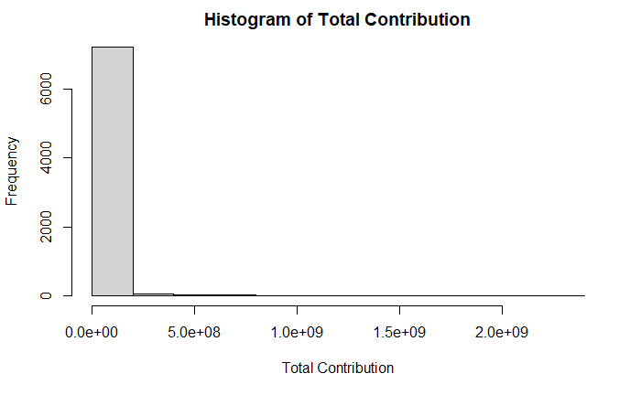
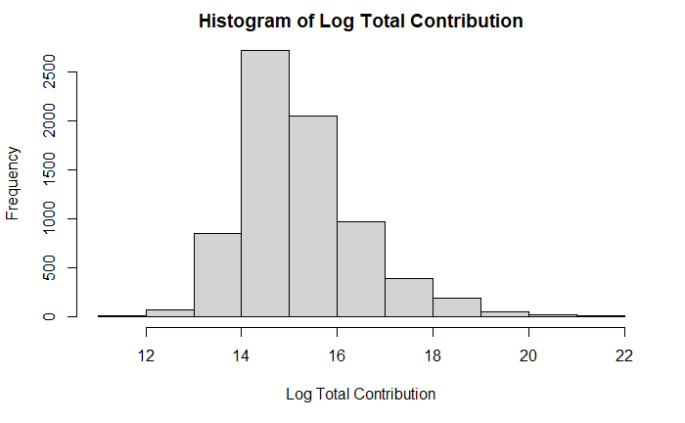
Total Contributions

Slide 4
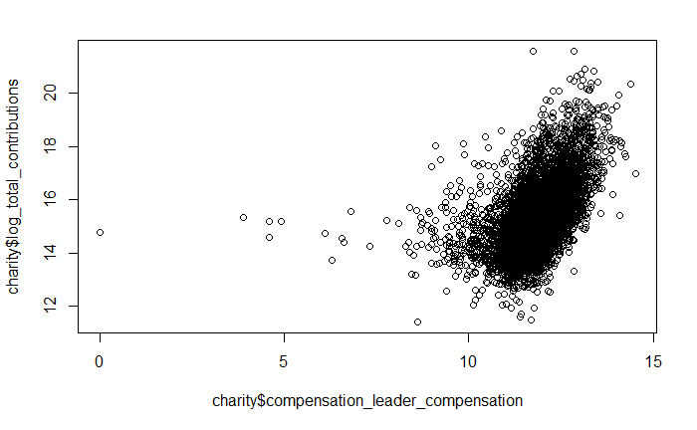
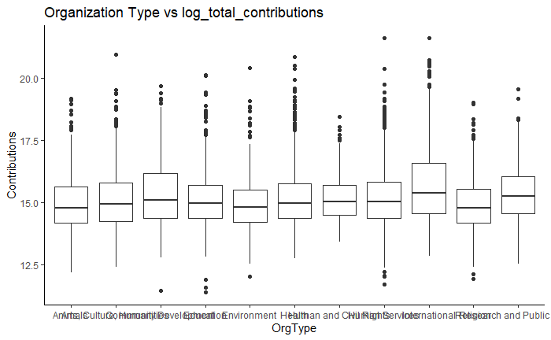
EDA
All financial metrics needed to be logged

Slide 5
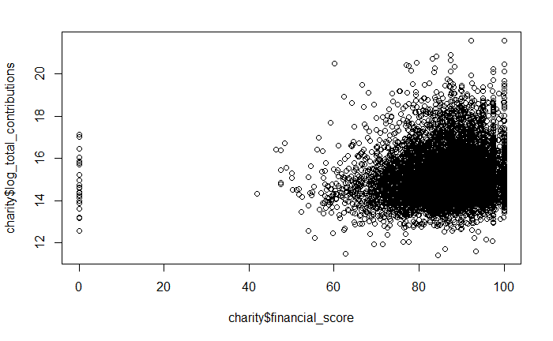
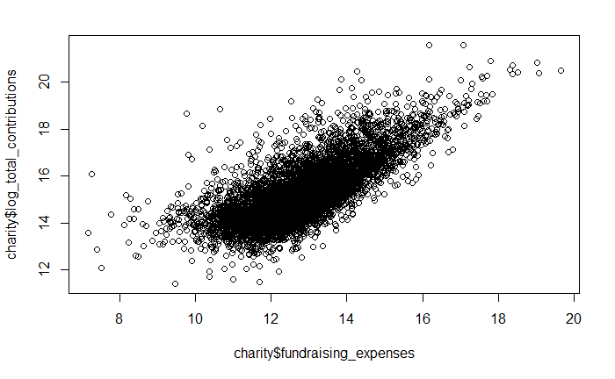
EDA (cont.)

Slide 6
AIC vs BIC
AIC:
lm(formula = log_total_contributions ~ fundraising_expenses +
financial_score + organization_type + compensation_leader_compensation +
accountability_score + organization_type:compensation_leader_compensation +
fundraising_expenses:organization_type + fundraising_expenses:accountability_score +
compensation_leader_compensation:accountability_score, data = charity)
BIC:
lm(formula = log_total_contributions ~ fundraising_expenses +
financial_score + organization_type + compensation_leader_compensation +
organization_type:compensation_leader_compensation, data = charity)

Slide 7
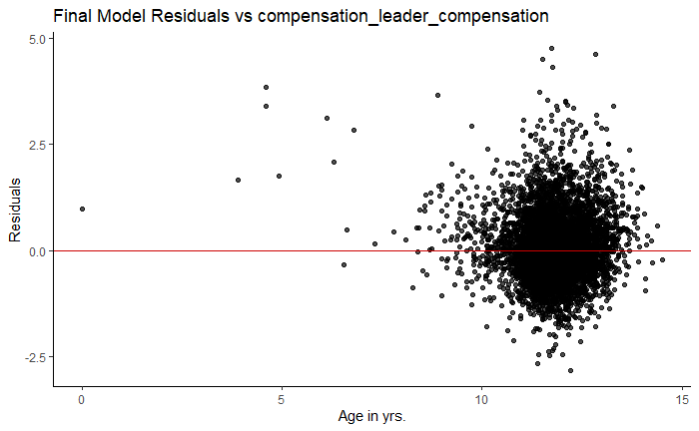
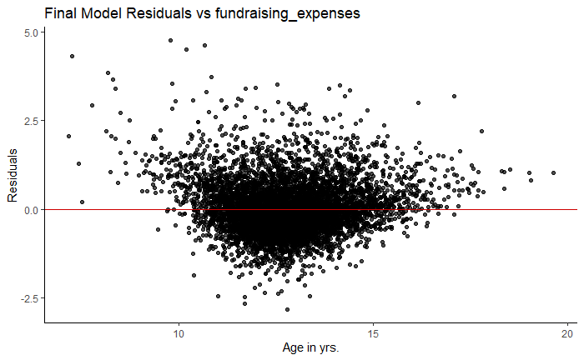
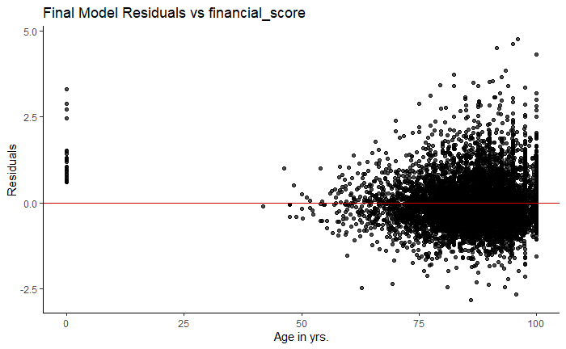
BIC Model Assumption Checking

Slide 8
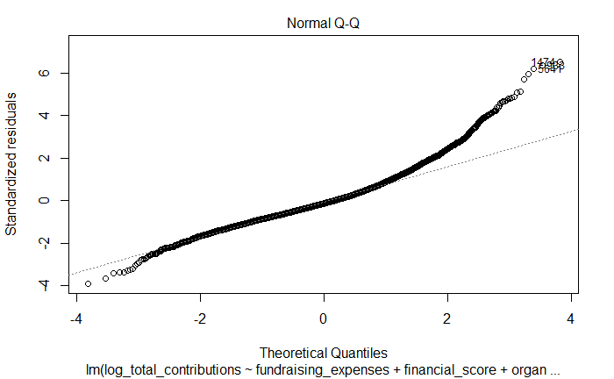
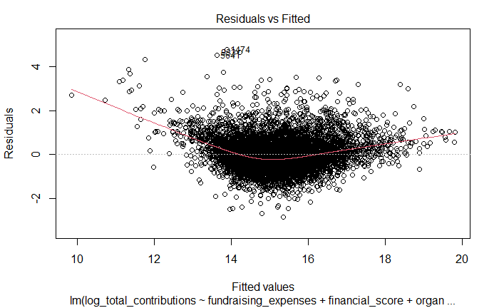
Other Assumptions

Slide 9
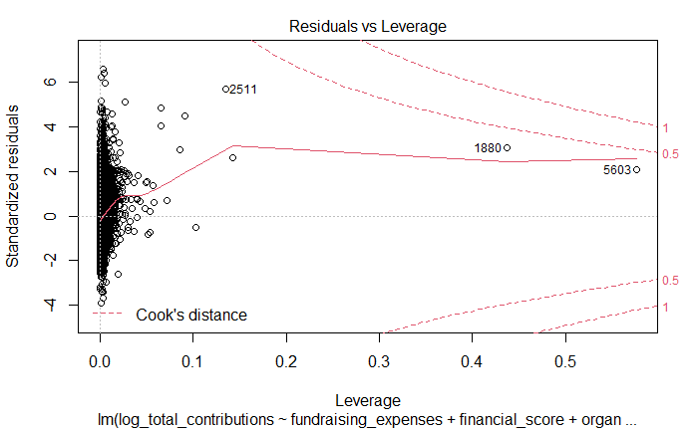
Outliers

Slide 10
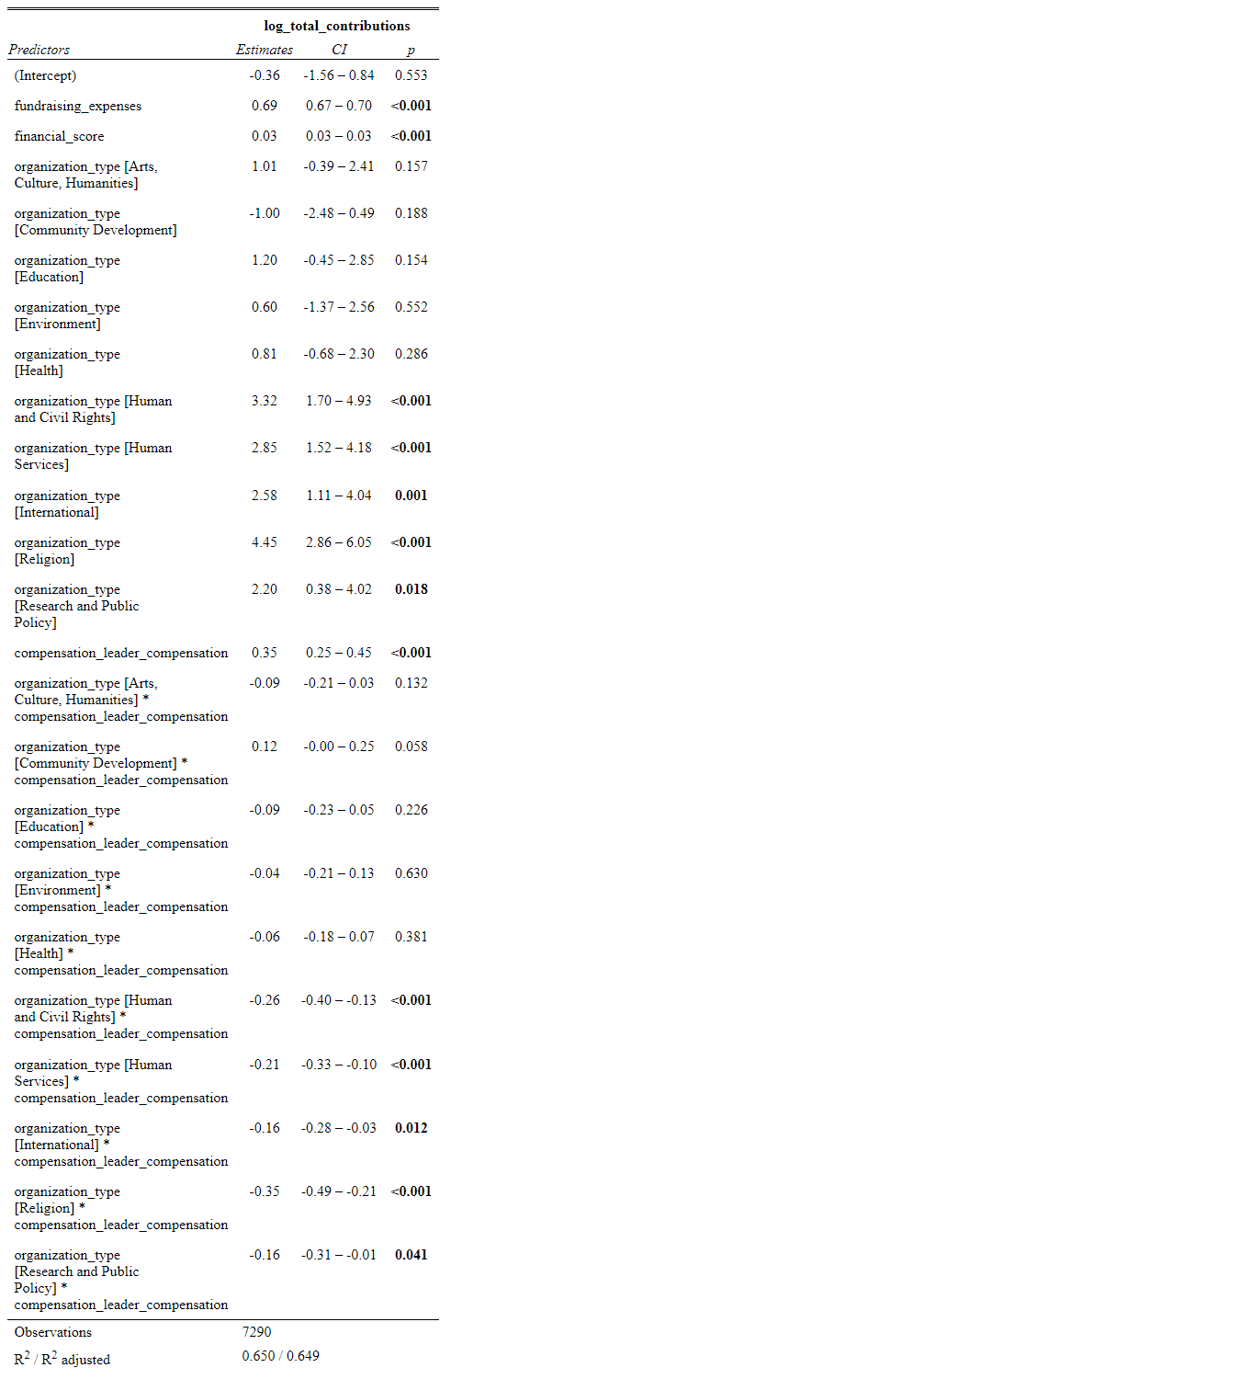
Coefficients

Slide 11
Limitations / Conclusions
A lot of the financial metrics were heavily co-correlated so only few were able to be used to minimize correlation between variables
VIF value is still high for some values especially with the presence of interaction terms
Fundraising expenses does have a large impact on total contributions gained
Orgs such as religion received way more contributions compared to community development
The interaction between religion org type and compensation for the leaders has the largest effect of the two predictors on fundraising amount

